Slide 1
TELECOM NETWORK OPERATIONS · CAPSTONE I
Telecom Network
Intelligence Platform
AI-Powered NOC Monitoring, Anomaly Detection & Network Risk Prediction
Python
PySpark
Machine Learning
FastAPI
React
Data Engineering → ML Intelligence → Risk & Anomaly Detection → FastAPI → React NOC Dashboard
01

Slide 2
INDUSTRY PROBLEM
Manual NOC Monitoring Doesn't Scale
High-volume telemetry across every network cell
RAW TELEMETRY FEED
Difficult to spot abnormal behavior in real time
cell_4417
SMS+CALL+NET
Operations stay reactive rather than proactive
cell_1182
spike detected
Alerts aren't correlated with geography
cell_2290
normal
cell_0033
no correlation
Limited historical pattern analysis
cell_5561
critical volume
No unified, single-pane NOC view
cell_1004
normal
cell_7702
unclassified
Converting raw network activity into structured analytics and ML-based intelligence solves this operational gap.
03

Slide 3
BUSINESS OBJECTIVES
Six Goals Driving the Platform Design
01
02
03
Network Visibility
Automated Detection
Risk Prediction
Centralized view of network activity and health.
Identify abnormal activity and alerts without manual scanning.
Prioritize potentially high-risk, high-activity network cells.
04
05
06
Geographic Intelligence
Operational Prioritization
Scalable Architecture
Visualize hotspots, alerts, and grid-level risk on the map.
Help NOC engineers focus on the conditions that matter most.
Modular data engineering, ML, API, and UI layers.
04

Slide 4
SOLUTION OVERVIEW
One Pipeline, Five Coordinated Layers
1
2
3
4
5
Data
Engineering
ML
API
NOC
CSV + GeoJSON
PySpark, Airflow(ETL)
Risk + Anomaly
FastAPI
React Dashboard
Network Activity Data → Data Engineering → ML Intelligence → Risk & Anomaly Detection → FastAPI → React NOC Dashboard → NOC Investigation
Each layer is independently testable and scalable — data engineering does not depend on model choice, and the UI consumes only clean REST responses.
05

Slide 5
SYSTEM ARCHITECTURE
End-to-End Enterprise Architecture
SOURCES
Network Activity CSV · Milan Grid GeoJSON
▼
DATA ENGINEERING
Pipeline Stages
▼
ANALYTICS DATA
Processed / Analytics Layer
▼
MACHINE LEARNING
Features → Risk Prediction → Anomaly Detection → Batch Scoring
▼
SERVICE LAYER
FastAPI REST Services
▼
PRESENTATION
React NOC Dashboard
▼
OPERATIONS
NOC Engineer → Investigation / Action
06

Slide 6
DATA ENGINEERING
Raw Telemetry to Analytics-Ready Data
Landing
Raw
Reference
Processed
Analytics
Sources
Analytics Outputs
SMS / Call / Internet activity CSV
Hourly grid summary
Network activity data
Daily grid summary
milano-grid.geojson
cellId → grid_id mapping
Hotspots
Data Engineering converts raw network activity into clean, structured data suitable for ML and dashboard consumption.
Alerts
Risk-related data
07

Slide 7
MACHINE LEARNING PIPELINE
From Features to Batch Scoring
ML2
ML3
ML4
ML6
Feature Engineering
Risk Prediction
Anomaly Detection
Batch Scoring
Feature Set (ML2)
Risk Model (ML3)
avg_activity
activity_growth
Decision Tree Risk Model — v1
active_hours
peak_ratio
Label: Future activity > 1.25 × trailing 24-hour median → high-activity / risk condition.
variability
internet_share
80% Train
20% Test
activity_vs_baseline
baseliine_gap
Feature engineering uses historical / trailing activity windows with leakage prevention.
XGBoost / LightGBM: future experimentation only, not deployed.
08

Slide 8
RISK & ANOMALY INTELLIGENCE
Turning Scores into Operational Status
NORMAL
ATTENTION
HIGH
Activity within expected trailing baseline range.
Deviation detected; worth NOC monitoring.
Risk score / anomaly exceeds operational threshold.
Anomaly & Risk Scoring Flow
Grid Activity
Risk Score
Anomaly Score
Severity Tag
NOC Priority Queue
09

Slide 9
GEOGRAPHIC INTELLIGENCE
Where Is the Problem, Not Just What
NORMAL
ATTENTION
HIGH
Grid ID
Network Activity
Risk
Alerts
Hotspots
Geographic Location
Neighboring Grids
Geographic context shifts the question from “what” to “where” — critical for field dispatch.
10
MILAN NETWORK GRID — ILLUSTRATIVE STATUS OVERLAY

Slide 10
FASTAPI BACKEND
A Clean Service Layer for the NOC
React
Axios / API Client
FastAPI
Analytics + ML Outputs
Key Endpoints
GET
/network/summary
GET
/network/grid/{grid_id}
GET
/network/hotspots
GET
/network/alerts
GET
/network/grid/{grid_id}/features
POST
/network/predict-risk
GET
/pipeline/status
GET
/network/grid/{grid_id}/location
GET
/network/grid/{grid_id}/neighbours
11

Slide 11
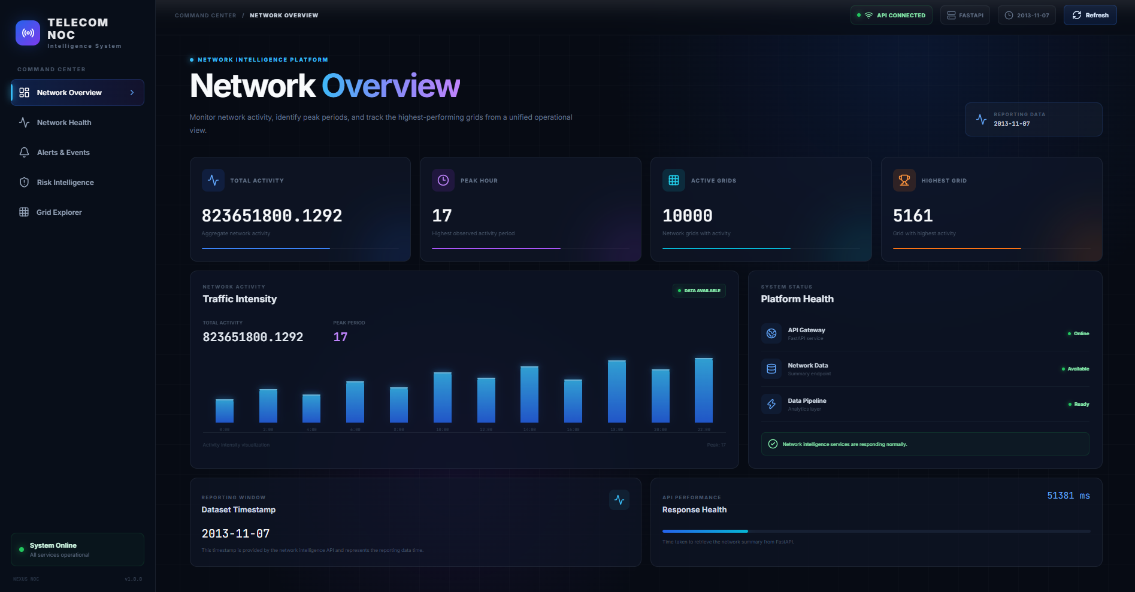
REACT NOC DASHBOARD
One Interface for Investigation
Dashboard / Network Overview
Network Health
Alerts & Events + Geographic Map
Risk Intelligence
▢
Grid Explorer / Grid Details
[ INSERT ACTUAL REACT DASHBOARD SCREENSHOT ]
Interface Building Blocks
Dark, enterprise-style NOC interface — captured from the live application
• KPI cards
• Tables & charts
• Status indicators
• Alert severity
• Geographic maps
• Pipeline status
12

Slide 12
OPERATIONAL WORKFLOW
From Reactive Monitoring to Investigation
1
2
3
4
5
6
OBSERVE
DETECT
PRIORITIZE
CORRELATE
INVESTIGATE
ACT
Network telemetry
Anomaly / alert
ML risk score
Grid + geography + neighbors
Grid-level evidence
NOC operational response
From reactive monitoring to intelligence-assisted investigation.
13

Slide 13
BUSINESS & OPERATIONAL IMPACT
What the Platform Changes for the NOC
1
2
3
4
Improved Visibility
Faster Prioritization
Geographic Context
Reduced Manual Effort
A single, consolidated view replaces fragmented raw feeds.
Risk-scored cells surface the conditions that matter first.
Alerts are tied to location, not just an abstract ID.
Structured analytics narrow the scope of investigation.
These outcomes follow directly from the implemented pipeline — no performance figures or ROI are claimed beyond the architectural capability demonstrated.
14

Slide 14
ENTERPRISE SECURITY & FUTURE ARCHITECTURE
Hardening the Platform for Production
Planned Security Architecture
Role-Based Access Control (RBAC)
Enterprise User
Admin
Everything + user mgmt
▼
NOC Manager
Dashboard, Alerts, Risk, Ops
Login / SSO
NOC Engineer
Dashboard, Network, Alerts
Analyst
Dashboard, Network, Reports
▼
Viewer
Read-only
Authentication
Enforced in both React and FastAPI — hiding a page client-side is not security.
▼
React NOC Dashboard
▼
LLM-Assisted Explanations (Future)
FastAPI Authorization
JWT authentication + password hashing
▼
Audit logs: user → action → resource → timestamp
MySQL + ML APIs + Data/ETL
HTTPS, CORS restrictions, rate limiting
Claude API operational explanation layer (future)
15

Slide 15
ROADMAP
Current Implementation to Enterprise Scale
LIVE
Current
Security
LLM Insights
Streaming
Automation
Scale
Data Engineering, ML, FastAPI, React NOC dashboard
JWT auth, RBAC, audit logs, HTTPS hardening
Claude API network insight generator
Real-time ingestion pipelines
Automated remediation workflows
Multi-vendor & multi-region support
Implemented items are marked LIVE; all other phases are Future Scope and are not part of the current deployed system.
16

Slide 16
CONCLUSION
From Raw Network Telemetry to
Actionable Network Intelligence
The Telecom Network Intelligence Platform transforms raw network telemetry into structured analytics, applies machine learning to identify risk and abnormal behavior, adds geographic context, exposes intelligence through APIs, and presents it through an enterprise NOC dashboard to support faster, more informed network investigation.
Data Engineering
Machine Learning
FastAPI
React NOC UI
Telecom Network Intelligence Platform · Capstone I
17

